Slide 1

Information Technology Institute
Operating System Fundamentals

Slide 2
CLOUD COMPUTING
OVERVIEW

Slide 3
Table of Content
Introduction
What is Cloud?
What is Cloud Computing
Cloud Computing Architecture
Deployment Models
Service Models
Virtualization
Cloud Computing Features and Challenges

Slide 4
INTRODUCTION

Slide 5
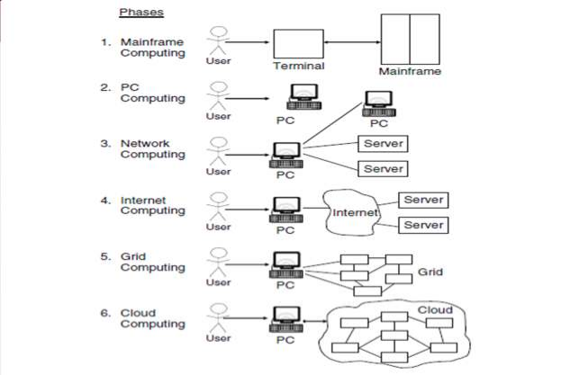
Computing History
Clustered system

Slide 6
Cloud Computing History
Concept evaluated in 1950(IBM) called RJE (Remote Job Entry Process).
In 2006 Amazon provided first public cloud AWS (Amazon Web Service).

Slide 7
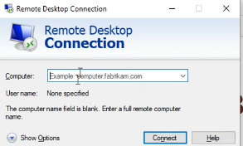
Remote desktop
Username = password
Cost per hour per day

Slide 8
What is Cloud?
The term cloud refers to Network or Internet. Something that is present in at remote location.
Cloud can provide
Services over network (on Public networks or on Private networks).
Applications such as email, web conferencing, customer relationship management (CRM)

Slide 9
What is Cloud Computing?
Cloud computing can be defined as a new style of computing in which dynamically scalable and often virtualized resources are provided as a services over the Internet.
Cloud computing refers to manipulating, configuring, and accessing the application online. It offers online data storage, infrastructure and application.
Cloud computing is both combination of software and hardware based computing resources delivered as a network service.

Slide 10
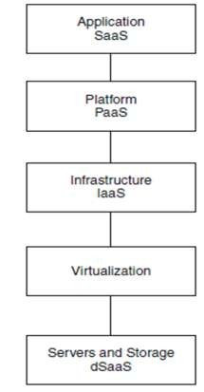
Cloud Computing Layered Architecture

Slide 11
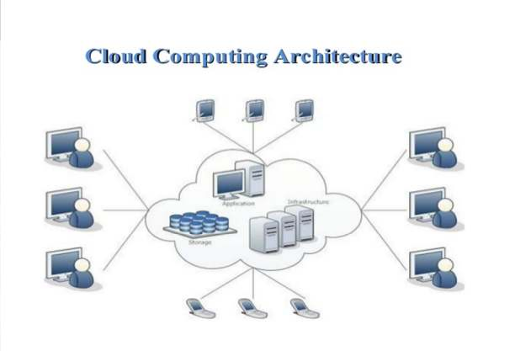
Cloud Computing Architecture

Slide 12
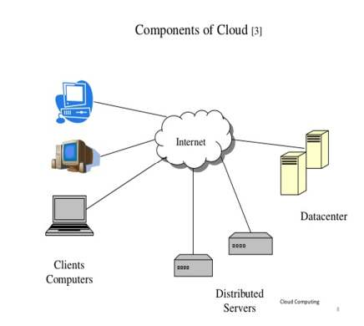
Cloud Components
Client computers
Datacenters
Distributed Servers

Slide 13
Clients
Clients are the devices that the end user interact with cloud.
Clients can be:
Thick
Thin
Mobile

Slide 14
Datacenter & Distributed Servers
Datacenter is a collection of servers where applications is placed and is accessed via internet.
Distributed Servers are in different places geographically, but they are working as if they are next to each other.

Slide 15
Central Server
It administrates the system such as monitoring traffic, clients requests to ensure everything runs smoothly.
It uses a special type of software called middleware.
Middleware software allows computers to communicate with each other.

Slide 16
Models for Cloud Computing
Deployment models
Service models

Slide 17
Deployment Models
Deployment models define the type of access to the cloud.
There are four types of access
Public
Private
Hybrid
Community

Slide 18
Deployment Models cont’d
Public cloud
It allows systems and services to be accessible to the general public.
It may be less secure due to its openness (email).
Private cloud
It allows systems and services to be accessible within an organization
It is more secure due to its private nature

Slide 19
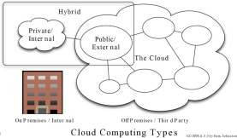
Deployment Models cont’d
Hybrid cloud
It is a mixture
of public and private cloud
The critical activities are performed using private cloud while non critical activities are performed using public cloud.
Community cloud
It allows systems and services to be accessible by a group of organizations
.

Slide 20
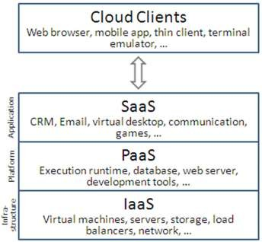
Service Models
Infrastructure (IaaS)
Platform (PaaS)
Software (SaaS)
Network (NaaS)
Database (DBaaS)

Slide 21
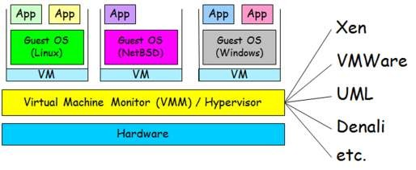
Virtualization
VM technology allows multiple virtual machines to run on a single physical machine

Slide 22
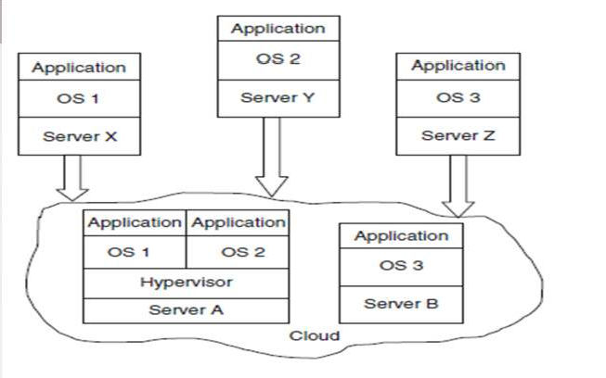
Virtualization

Slide 23
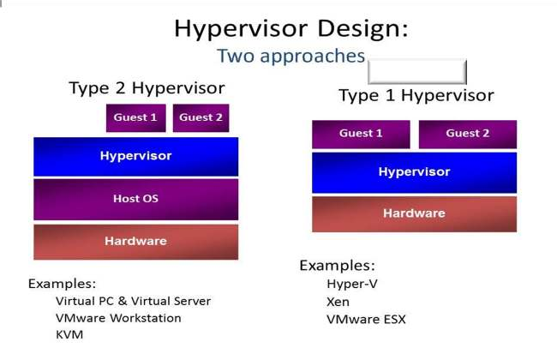

Hypervisor Types
Hosted
Bare Metal
Cloud

Slide 24
Virtualization
Advantages of virtual machines:
Run operating systems where the physical hardware is unavailable.
Easier to create new machines, backup machines, etc.
Software testing using “clean” installs of operating systems and software.
Emulate more machines than are physically available.
Timeshare lightly loaded systems on one host.
Debug problems (suspend and resume the problem machine).
Easy migration of virtual machines (shutdown needed or not)
Run legacy systems!

Slide 25
Cloud Computing Features
Scalability and on-demand services
User-centric interface
Guaranteed Quality of Service (QoS)
Autonomous system
Pricing

Slide 26
Cloud Computing Challenges
Performance - scalability
Security and Privacy
Control
Bandwidth Costs
Reliability

Slide 27



